Slide 1


Lecture Capture at Newcastle University
1st March 2013
Phil Ansell, Maths & Stats and Chair of the ReCap Education Steering Group

Slide 2

What is ReCap?
An automated event recording and delivery system powered by Panopto
No “talking head”
Available in 62 teaching spaces
Also available as a software installation for “personal captures”
Access restricted to staff and students by default but this can be changed
Made available via the VLE in a streaming format.

Slide 3
Uses for ReCap
Lecture capture
Pre-lectures
Additional material
Exam revision materials
Feedback
Seminars
Recruitment and outreach

Slide 4
How ReCap works in a lecture theatre
Recordings are scheduled
Use a microphone when presenting the session
After the session the recording can be edited
Make the link available to students when you wish
Students access recordings via the VLE
Use the pause functionality for any sections you do not wish to record
http://teaching.ncl.ac.uk/recap/

Slide 5
ReCap (lecture room) statistics
Year | Number of Recordings | Number of enabled venues | Number of Viewings
2007/08 (S2 only) | 18 | 6 | 120
2008/09 | 444 | 18 | 59,984
2009/10 | 1,150 | 21 | 123,018
2010/11 | 3,872 | 50 | 222,507
2011/12 | 7,914 | 61+3 (NuMed) | 363,534
2012/13 (S1 only) | 7,945 | 62+3 (NuMed) | 191,943

Slide 6
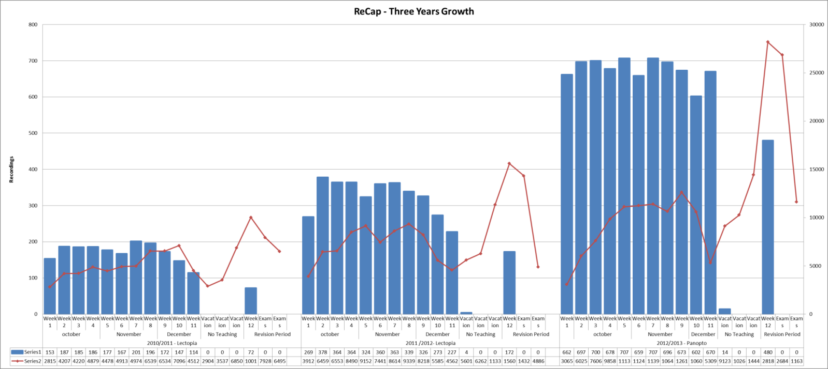
Semester 1
2010/11, 2011/12 and 2012/13

Slide 7
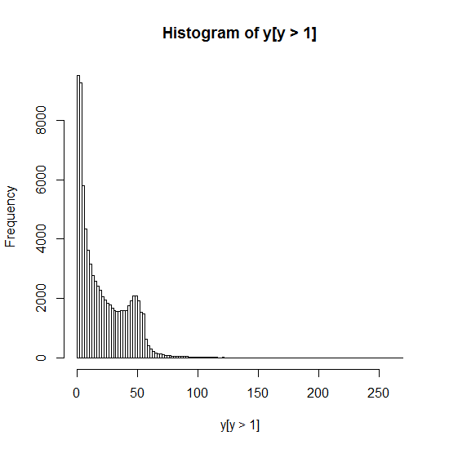

Slide 8
Student Experience
Recordings are accessed via the VLE
Functionality:
  Available on desktop and mobile devices
  Searchable
  Note taking

Slide 9
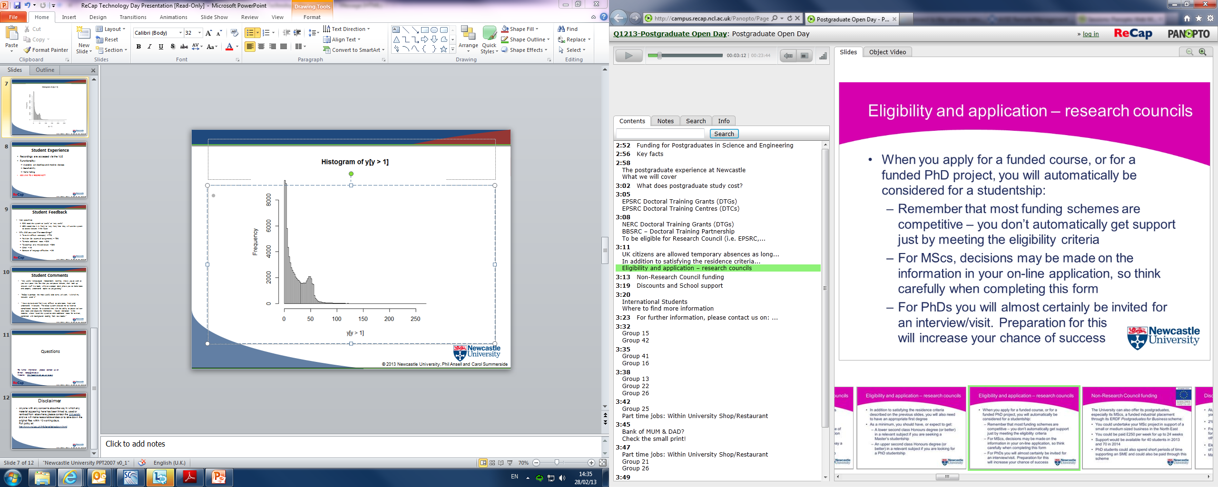

Slide 10
Student Feedback
Very positive:
  92% rated the system as ‘useful’ or ‘very useful’
  89% stated that it is ‘likely’ or ‘very likely’ that they will use the system to access lectures in the future
Why did you use the recordings?
  To revisit difficult concept(s) – 77%
  Revision (for exams of assignments) – 75%
  To make additional notes – 62%
  To catch-up on a missed lecture – 58%
  Other – 4%
  Because of language difficulties – 3%

Slide 11
Student Comments
“Very useful - encouraged independent learning. Allows you to work at your own pace - the fact that you can pause lectures, then look up relevant stuff in a book, whilst at a proper desk allows you to make notes and properly understand topics as you go along.”
“ReCap is perhaps the most useful aide to my uni work. I wish all my lecturers used it.”
“I have dyslexia and find it very difficult to take notes, listen and understand in lectures. The recap system allowed me to listen to complicated lectures for a second time with the ability to pause so I can take notes and digest the information. I found I did better in the modules where I used the system to take additional notes for revision, combined with background reading from text books.”

Slide 12
Questions
For further information, please contact us on:
E-mail: recap@ncl.ac.uk
Website: http://teaching.ncl.ac.uk/recap

Slide 13
Disclaimer
Anyone with any concerns about the way in which any material appearing here has been linked to, used or remixed from elsewhere, please contact the University and we will make reasonable endeavor to take down the original files within 10 working days.
Full policy at: http://www.ncl.ac.uk/info/legal/takedown.html

